Slide 1
Introduction to Statistical Methods
Dr Y V K Ravi Kumar, BITS- Pilani

Slide 2
Session 3: Bayes theorem , Random Variables
II Semester 2019 -20(Aug 2020)

Slide 3
Agenda
Conditional Probability _ Revise
Total Probability _ Revise
Bayes Theorem
Random variable
Discrete Random variable
Continuous random variable
3

Slide 4


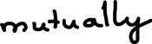

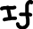
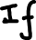
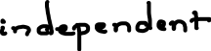
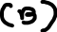
RECAP

Slide 5










RECAP

Slide 6














RECAP

Slide 7
Example 2.26 (page 75)
A news magazine publishes three columns entitled “ART”(A),”BOOKS”(B) and “CINEMA:(C). Reading habits of a randomly selected reader with respect to these columns are
a) Find the probability that he follows ART given that he read BOOKS regularly.
b) Find the probability that he follows ART given that he regularly follows at least
BOOKS or CINEMA.
c) Find the probability that he follows ART given that he regularly follows at least
one.
d) Find the probability that he follows atleast ART or BOOKS given that he follows
cinema regularly.
Read Regularly | A | B | C | A & B | A & C | B&C | A&B&C
Probability | 0.14 | 0.23 | 0.37 | 0.08 | 0.09 | 0.13 | 0.05

Slide 8


Read Regularly | A | B | C | A & B | A & C | B&C | A&B&C
Probability | 0.14 | 0.23 | 0.37 | 0.08 | 0.09 | 0.13 | 0.05
a) Find the probability that he follows ART given that he read BOOKS regularly.

Slide 9









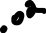
Read Regularly | A | B | C | A & B | A & C | B&C | A&B&C
Probability | 0.14 | 0.23 | 0.37 | 0.08 | 0.09 | 0.13 | 0.05
b) Find the probability that he follows ART given that he regularly follows at least BOOKS or CINEMA

Slide 10
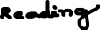


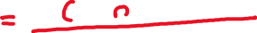





c) Find the probability that he follows ART given that he regularly follows at least one.

Slide 11
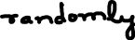
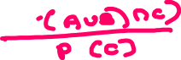
d) Find the probability that he follows atleast ART or BOOKS given that he follows cinema regularly.

Slide 12
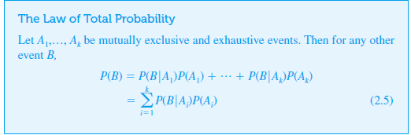

Slide 13
1
Three persons A,B and C are competing for the post of CEO of a company. The chances of they becoming CEO are 0.2,0.3 and 0.4 respectively.
The chances of they taking employees beneficial decisions are 0.50,0.45 and 0.6 respectively
What are the chances of having employees beneficial decisions after having new CEO

Slide 14
Example 2.30
An individual has 3 different email accounts. Most of her messages, in fact 70%, come into account #1, whereas 20% come into account #2 and the remaining 10% into account #3.
Of the messages into account #1, only 1% are spam, whereas the corresponding percentages for accounts #2 and #3 are 2% and 5%, respectively.
What is the probability that a randomly selected message is spam?

Slide 15
Example 2.30
cont’d
To answer this question, let’s first establish some notation:
A_{i} = {message is from account # i} for i = 1, 2, 3,
B = {message is spam}
Then the given percentages imply that P(A₁) = .70, P(A₂) = .20, P(A₃) = .10

Slide 16
Example 2.30
cont’d
Now it is simply a matter of substituting into the equation for the law of total probability: P(B) = (.01)(.70) + (.02)(.20) + (.05)(.10) = .016 In the long run, 1.6% of this individual’s messages will be spam.

Slide 17
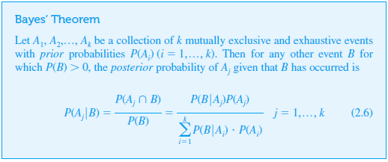
Bayes’ Theorem

Slide 18
Example 2.30
An individual has 3 different email accounts. Most of her messages, in fact 70%, come into account #1, whereas 20% come into account #2 and the remaining 10% into account #3.
Of the messages into account #1, only 1% are spam, whereas the corresponding percentages for accounts #2 and #3 are 2% and 5%, respectively.
What is the probability that a randomly selected spam message is from account #1 ?

Slide 19
Example
In a city patients visits three doctors A,B and C in the ratio 6:5:7.The chance that these doctors refers a case to a specialist are 54%,60% and 55% respectively.
If a patient visits a specialist , what is the probability that he is referred by doctor A

Slide 20
EXAMPLE
WEATHER | PLAY | WEATHER | PLAY
SUNNY | YES | SUNNY | YES
OVERCAST | NO | OVERCAST | NO
RAINY | NO | RAINY | NO
SUNNY | YES | SUNNY | YES
SUNNY | NO | RAINY | NO
RAINY | YES | OVERCAST | YES

Slide 21
Example
FRUIT | LONG | SWEET | YELLOW
ORANGE | 400 | 350 | 450
BANANA | 0 | 150 | 300
OTHERS | 100 | 150 | 50
Total | 500 | 650 | 800

Slide 22
EXAMPLE
Doc 1: I hated the movie
Doc 2: I loved the movie
Doc 3: A great and good movie
Doc 4: Poor acting
Doc 5: Great acting and good movie

Slide 23
NAÏVE Bayes Theorem / Classifier

Slide 25
Random variables

Slide 26
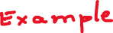
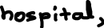
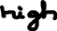
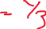
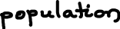

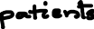


Slide 27
Random Variables
A random variable is a variable hat assumes numerical values associated with the random outcome of an experiment, where one (and only one) numerical value is assigned to each sample point.

Slide 28
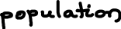

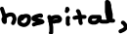



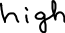

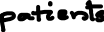


Slide 29
Random Variables
A random variable is a numerical description of the outcome of an experiment.
A random variable can be classified as being either discrete or continuous depending on the numerical values it assumes.
A discrete random variable may assume either a finite number of values or an infinite sequence of values.
A continuous random variable may assume any numerical value in an interval or collection of intervals.

Slide 30
Random variable
Types of random variables
Two types of random variables
Discrete random variable:
A random variable which take on countable numbers (may be finite or countable infinite values) i.e., without decimal like Natural #s, Whole #s, Integers etc.
Continuous random variable:
A random variable which take on any values in an interval i.e., in the set of real #s which includes, negative, positive, rational, irrational, decimal etc

Slide 31


Types of Random Variables
Discrete random variables
Number of sales
Number of calls
Shares of stock
People in line
Mistakes per page
Continuous random variables
Length
Depth
Volume
Time
Weight

Slide 33
Probability Distributions for Discrete Random Variables
The probability distribution of a discrete random variable is a graph, table or formula that specifies the probability associated with each possible outcome the random variable can assume.
p(x) ≥ 0 for all values of x
Σp(x) = 1

Slide 34
Expected Values of Discrete Random Variables
The mean, or expected value, of a discrete random variable is

Slide 35
Expected Values of Discrete Random Variables
The variance of a discrete random variable x is
The standard deviation of a discrete random variable x is

Slide 36
Continuous Probability Distributions
Probability density function, denoted by f(x), which provides the probability for each value of the random variable.
The required conditions for a discrete probability function are:
f(x) > 0
Σf(x) = 1

Slide 38







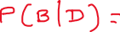

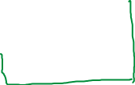
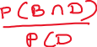
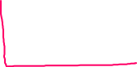

Slide 39




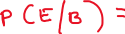



Slide 40
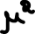


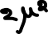


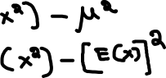

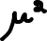




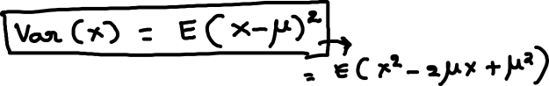


Slide 41
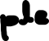
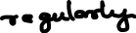
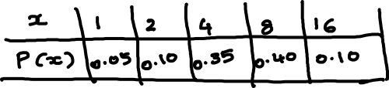

Slide 42
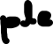

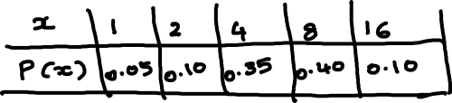

Slide 43





Slide 44

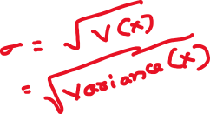

Slide 45
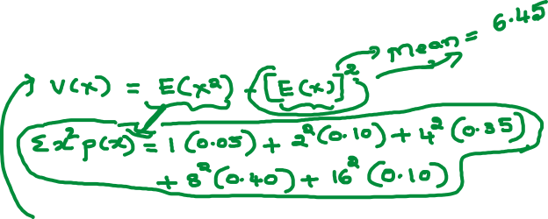

Slide 46
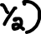


Slide 47
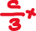
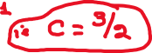


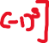

Slide 48



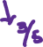
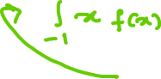




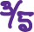

Slide 49
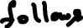
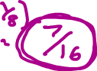

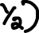
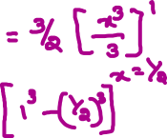




Slide 50
Statistical Methods for Data Science
Random variable
Probability Distribution
A random variable is a real valued function defined on the sample space Ω
With the introduction of X we can write the probabilities as
p(0) = P(X=0) = 0.0625
p(1) = P(X=1) = 0.2500
p(2) = P(X=2) = 0.3750
p(3) = P(X=3) = 0.2500
p(4) = P(x=4) = 0.0625 such that
p(0) + p(1) + p(2) + p(3) + p(4) = 1
and each p(x) ≥ 0, x = 0, 1, 2, 3, 4
Ω
X: Ω→R
R
0
1
2
3
4
0.0625
0.2500
0.3750

Slide 51


Check whether the following can serve as
Probability distributions
For what value of
c, this can be a
probability mass
function (pmf)?
Statistical Methods for Data Science
Probability Distribution
Discrete distribution
Example
No
Yes
with
c =1/30

Slide 52
Statistical Methods for Data Science
Probability Distribution
Discrete distribution
No. of defective RAM chips | Probability
0 | ⅛
1 | ⅜
2 | ⅜
3 | ⅛
Total | 1

Slide 53
Statistical Methods for Data Science
Probability Distribution
Discrete distribution
X = No. of defectives
X | 0 | 1 | 2 | 3
P(X=x) | 0.614 | 0.324 | 0.057 | 0.003

Slide 54

Statistical Methods for Data Science
Probability Distribution
Discrete distribution
Example 2:
Let X denote the random variable that is defined as the sum of two fair dice, then,
X=x | 2 | 3 | 4 | 5 | 6 | 7 | 8 | 9 | 10 | 11 | 12
P(X=x) | 1/36 | 2/36 | 3/36 | 4/36 | 5/36 | 6/36 | 5/36 | 4/36 | 3/36 | 2/36 | 1/36

Slide 55

Statistical Methods for Data Science
Probability Distribution
Cumulative Distribution Function
Let p(x) =P(X=x) is called a (discrete) probability distribution.
Let F(x) = P(X ≤ x). F(x) is called the Cumulative Distribution Function or Distribution Function (DF) of the discrete random variable X. F(x) has the following properties

Slide 56
Statistical Methods for Data Science
Probability Distribution
Cumulative Distribution Function
No. of defective RAM chips | Probability | Cumulative probability
0 | 0.125 | 0.125
1 | 0.375 | 0.500
2 | 0.375 | 0.875
3 | 0.125 | 1.000
Total | 1

Slide 57
Statistical Methods for Data Science
Probability Distribution
Discrete distribution function
Probability distributions can be estimated from relative frequencies. Consider the discrete (countable) number of televisions per household (X) from India survey data …
No. of televisions | No. of households | X | P(x)
0 | 1,218 | 0 | 0.012
1 | 32,379 | 1 | 0.319
2 | 37,961 | 2 | 0.374
3 | 19,387 | 3 | 0.191
4 | 7,714 | 4 | 0.076
5 | 2,842 | 5 | 0.028
Total | 101,501 |  | 1.000
1,218 ÷ 101,501
= 0.012
e.g. P(X=4) = P(4) = 0.076 =7.6%

Slide 58
Statistical Methods for Data Science
Probability Distribution
Discrete distribution function
What is the probability there is at least one television but no more than three in any given household?
No. of televisions | No. of households | X | P(x)
0 | 1,218 | 0 | 0.012
1 | 32,379 | 1 | 0.319
2 | 37,961 | 2 | 0.374
3 | 19,387 | 3 | 0.191
4 | 7,714 | 4 | 0.076
5 | 2,842 | 5 | 0.028
Total | 101,501 |  | 1.000
“at least one television but no more than three”
P(1 ≤ X ≤ 3) = P(1) + P(2) + P(3) = 0.319 + 0.374 + 0.191 = 0.884

Slide 59
Statistical Methods for Data Science
Probability Distribution
Cumulative Distribution Function
Let X denote the number of tires on a randomly
selected automobile that are underinflated.
(a) Which of the following three probability mass
functions is legitimate for X and why are the other or
not allowed?
X = x | 0 | 1 | 2 | 3 | 4
p₁(x) = P(X=x) | 0.30 | 0.20 | 0.10 | 0.05 | 0.05
p₂(x) = P(X=x) | 0.40 | 0.10 | 0.10 | 0.10 | 0.30
p₃(x) = P(X=x) | 0.40 | - 0.10 | 0.20 | 0.10 | 0.30

Slide 60
Statistical Methods for Data Science
Probability Distribution
Cumulative Distribution Function
A mail-order computer business has six telephone lines. Let X
denote the number of lines in use at a specified time. Suppose that
the pmf is as follows:
X = x | 0 | 1 | 2 | 3 | 4 | 5 | 6
p(x) = P(X=x) | 0.10 | 0.15 | 0.20 | 0.25 | 0.20 | 0.06 | 0.04
Calculate the probability that
(a) At most 3 lines are in use
(b) Fewer than 3 line in use
(c) At least 3 lines are in use
(d) Between 2 and 5 lines are in use
(e) At least four lines are not in use

Slide 61


Statistical Methods for Data Science
Probability Distribution
Cumulative Distribution Function
Find the probability mass function from a given
distribution function of X
P(X) = F(X) – F(X-1)

Slide 62



Statistical Methods for Data Science
Probability Distribution
Expected value and Variance
For a discrete random variable X with probability mass function p(x) = P(X=x), the E(X), E(X²) and V(X) are computed using the formulae
$$V\left(X\right)=E\left(X^{2}\right)−({E(X))}^{2}$$

Slide 63


Statistical Methods for Data Science
Probability Distribution
Expected value and Variance
How do you describe this probability distribution?
$$E\left(X\right)=0+0.13+0.40+0.84+1.00+0.25+0.18=2.8$$
$$E\left(X^{2}\right)=0+0.13+0.80+2.52+4.00+1.25+1.08=9.18$$
$$V\left(X\right)=E\left(X^{2}\right)−({E(X))}^{2}$$
$$V\left(X\right)=9.18−{(2.8}^{2})=1.94$$

Slide 64
Statistical Methods for Data Science
Probability Distribution
Expected value and Variance
Let X be a discrete random variable having the probability mass function
X = x | 0 | 1 | 2 | 3 | 4 | 5 | 6 | 7
# Registered | 150 | 450 | 1950 | 3750 | k | 2550 | 1500 | 300
Find the value of k
Find the probability distribution function of X
Calculate E(X) and V(X)
Assume N = 15000

Slide 65

Thank you

